Slide 1

The Journey:
There and Back Again
By Bilbo Baggins
Jenell Pizarro

Slide 2
Jenell Pizarro
Open Code Orlando
Twitter: @nellarro
Slack: @jenellpizarro
Portfolio: nellarro-portfolio.surge.sh
Front End Web Developer
Iron Yard Graduate

Slide 3
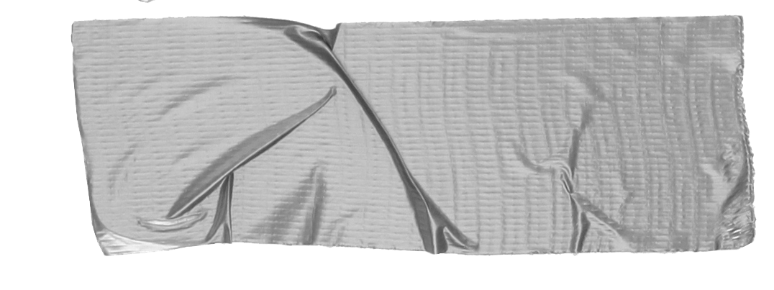

What do you need to know before learning any programming
language?
Hint
Look at all this empty space full of nothing.

Slide 4
Step One: Know Nothing
Everyone starts somewhere.
Notes:
The way that I got into coding was actually because I bought a makeup app and it was the worst mistake of my entire life (or the best mistake).
I decided that I could do it better because I am woman, hear me roar!
I soon figured out that I did not at all know the first thing about code and at that point in time, they did it much better than I could.

Slide 5

Alright! Now that you’ve got the first step down, let’s talk about what the remaining steps to becoming THE BEST LADY DEV you can be
Notes:
Coffee and/or tea is an absolute necessity.

Slide 6
Step 2
Find your Gandalf and let her (or him) tell you about the wonderful world of code.
Glimpse into their world
Are they front or back end? Do their eyes light up when speaking ‘bout code?
Support
Gandalf will be there when you’re mad at your Mac and when you’re happy dancing about your newfound skills.
Notes:
Find your Gandalf. Or let them find you. A really great way to find your Gandalf or let Gandalf find you is through Meet-ups like this one, ODevs, etc. You’re going to find a community that genuinely cares about working with people who are just as passionate as they are. If you’re shy or you feel like no one is talking to you, talk about cookies while you’re waiting in line for food. If they don’t start talking to you about cookies, you don’t need that kind of person in your life and they’re probably Smaug anyway so… psh.

Slide 7
Pause!
(If you haven’t already talked to some folks here, make a mental note on who you’d like to chat with and make it happen. )

Slide 8
Step 3
Get your feet wet.
Crash Courses: The Iron Yard
The Iron Yard? Girl, it’s in this building. And crash courses are free. And sometimes they feed you.
CodeSchool, Codecademy, Skillcrush, Free Code Camp
These places offer free online courses that help you get the basics. Want to know what HTML and CSS are? They got you. Loops? They got you. How to make waffles...umm Youtube?
Notes:
Crash courses are another way to meet people. Meeting people means you can make your fellowship (I know, wrong book) bigger. When I went to The Iron Yard in St. Peterburg, I met a ton of people that helped challenge me in Free Code Camp meetups or NodeSchool. We would get so competitive that we ended up building a Twitter bot in a few hours with no prior experience just because we wanted to see who could do it quicker and more effectively.

Slide 9

It’s now time to make the tough decision: Should I stay or should I go?
Tip
This is a big decision. Talk to the people around you.
Ask Gandalf, your fellowship what they would do or what they have done.
Notes:
For me, this was a tough decision because I wanted the best education I could get and fast. I had a full time job as a junior manager of the longest standing bar at Universal Studios, a job that any junior manager covets due to it’s hard work and almost guarantee of upper management in the company. It came down to: Am I happy?

Slide 10
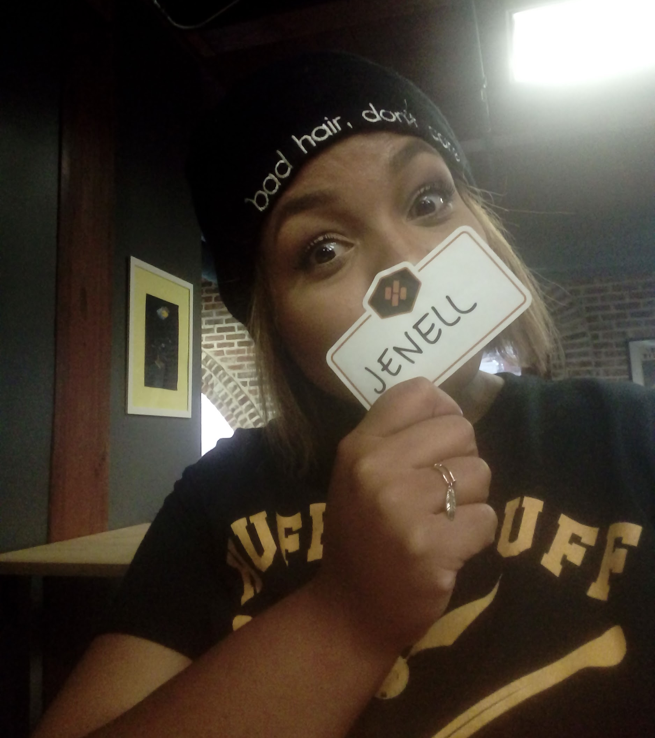
Meet Jenell.
This is her first day of The Iron Yard.
And she just learned what a <div> is.
Tip
If you do end up going this route to learn code, I suggest documenting it. You might hate the way you look 3 months later but every time you look at those pictures afterwards you’ll smile.
Notes:
Talk about your experiences at The Iron Yard.

Slide 11
In Review...
Know nothing.
You will soon. Find a cause to be passionate about and code for that cause.
Find your Gandalf and dwarves.
They’ll help you every step of the journey. They will even challenge you to greatness
Code
Whether you learn by going to meet-ups, free coding courses, or if you sign up for a boot camp like TIY, you won’t regret it.
Notes:
And now… Kiss and Makeup!

Slide 12
But wait, there’s more!
I made it better!
Remember that app I bought?

